Slide 1

Online Insurance Management System
S.Bhavana (192211410)
P.Bhargavi(192211104)

Slide 2


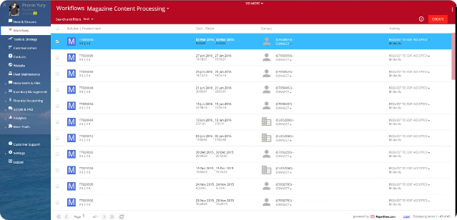
Online Insurance Management System
The online insurance management system provides a platform for managing all aspects of insurance policies, claims, and payments. It offers a seamless digital experience, empowering users to conveniently access and administer their insurance needs from anywhere.

Slide 3

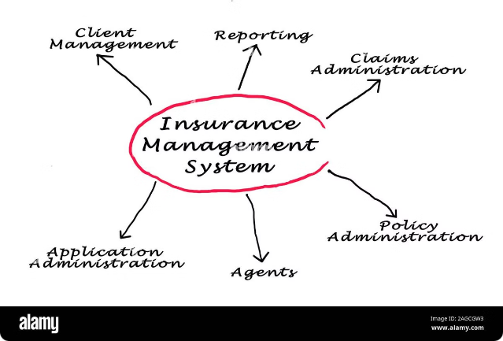
Introduction
1
Streamlined Policy Management
Easily view, update, and renew insurance policies all in one place.
2
Efficient Claims Handling
Submit, track, and manage insurance claims through a user-friendly interface.
3
Flexible Billing and Payments
Conveniently make payments, view billing history, and set up automatic payments.

Slide 4
Key Features
Policy Management
Claims Submission
Billing and Payments
Easily view, update, and renew insurance policies.
Submit and track insurance claims with ease.
Manage payments, view history, and set up automatic payments.

Slide 5

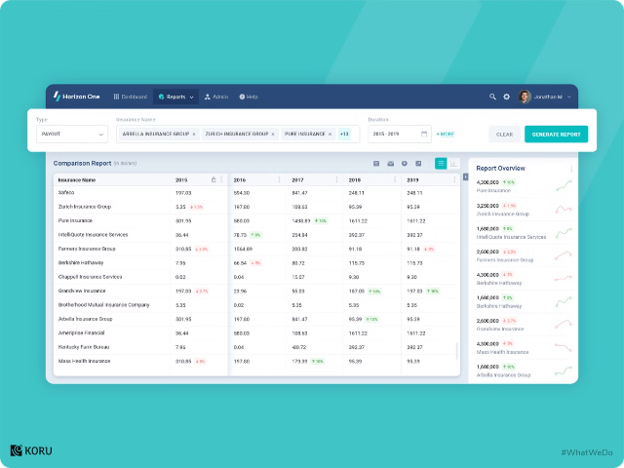
User Accounts and Profiles
Personalized Dashboards
Users can access a personalized dashboard to view their policy details and claims status.
Secure Login
Multi-factor authentication and encrypted login ensure the safety of user information.
Profile Management
Users can update their personal and contact information in their profile settings.

Slide 6

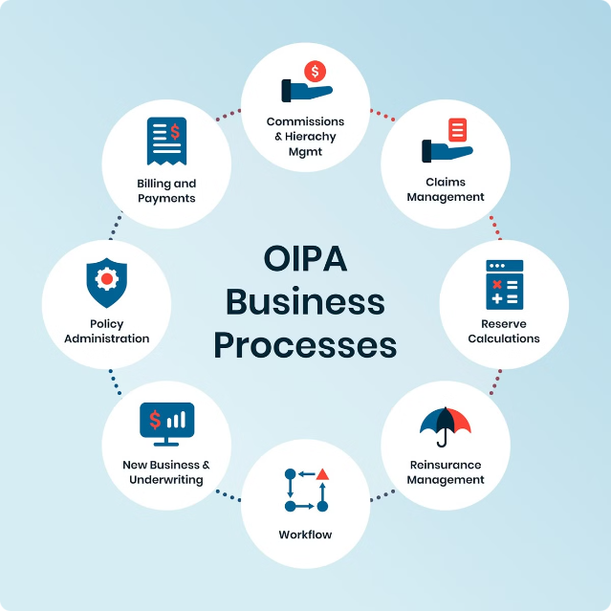
Policy Management
1
Policy Enrollment
Users can enroll in new insurance policies with just a few clicks.
2
Policy Updates
Easily modify policy details, such as coverage levels and deductibles, as needed.
3
Policy Renewal
Receive reminders and renew policies seamlessly to maintain continuous coverage.

Slide 7
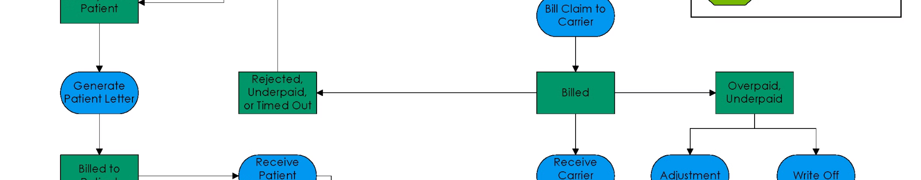
Billing and Payments
Premium Payments
Users can make one-time or recurring payments for their insurance premiums.
Automated Payments
Set up automatic payments to ensure timely premium payments and avoid lapses in coverage.
Payment History
Review a detailed history of all past payments and transaction details.

Slide 8
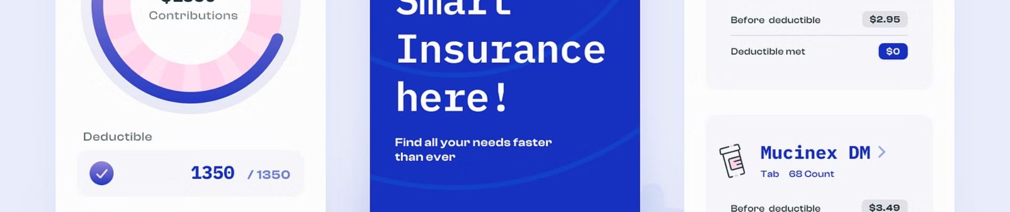
Mobile Accessibility
Responsive Design
Dedicated Mobile App
Offline Functionality
The system is optimized for seamless use on mobile devices, providing a consistent user experience.
Users can download a dedicated mobile app to access their insurance information on-the-go.
The mobile app offers offline access to key features, ensuring uninterrupted service.

Slide 9

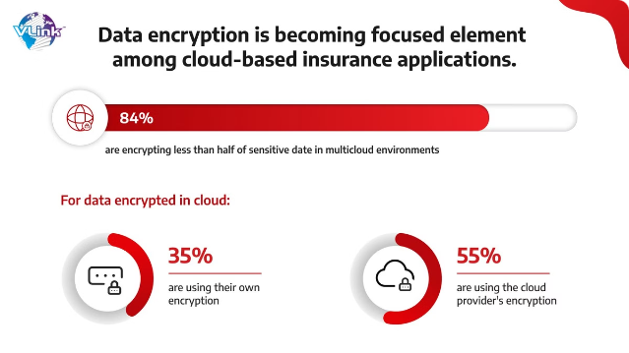
Data Security and Privacy
1
Encrypted Data Storage
All user data is stored securely using the latest encryption technologies.
2
Two-Factor Authentication
The system requires two-factor authentication to access sensitive information.
3
Compliance and Regulations
The platform adheres to industry-standard security and privacy regulations.

Slide 10
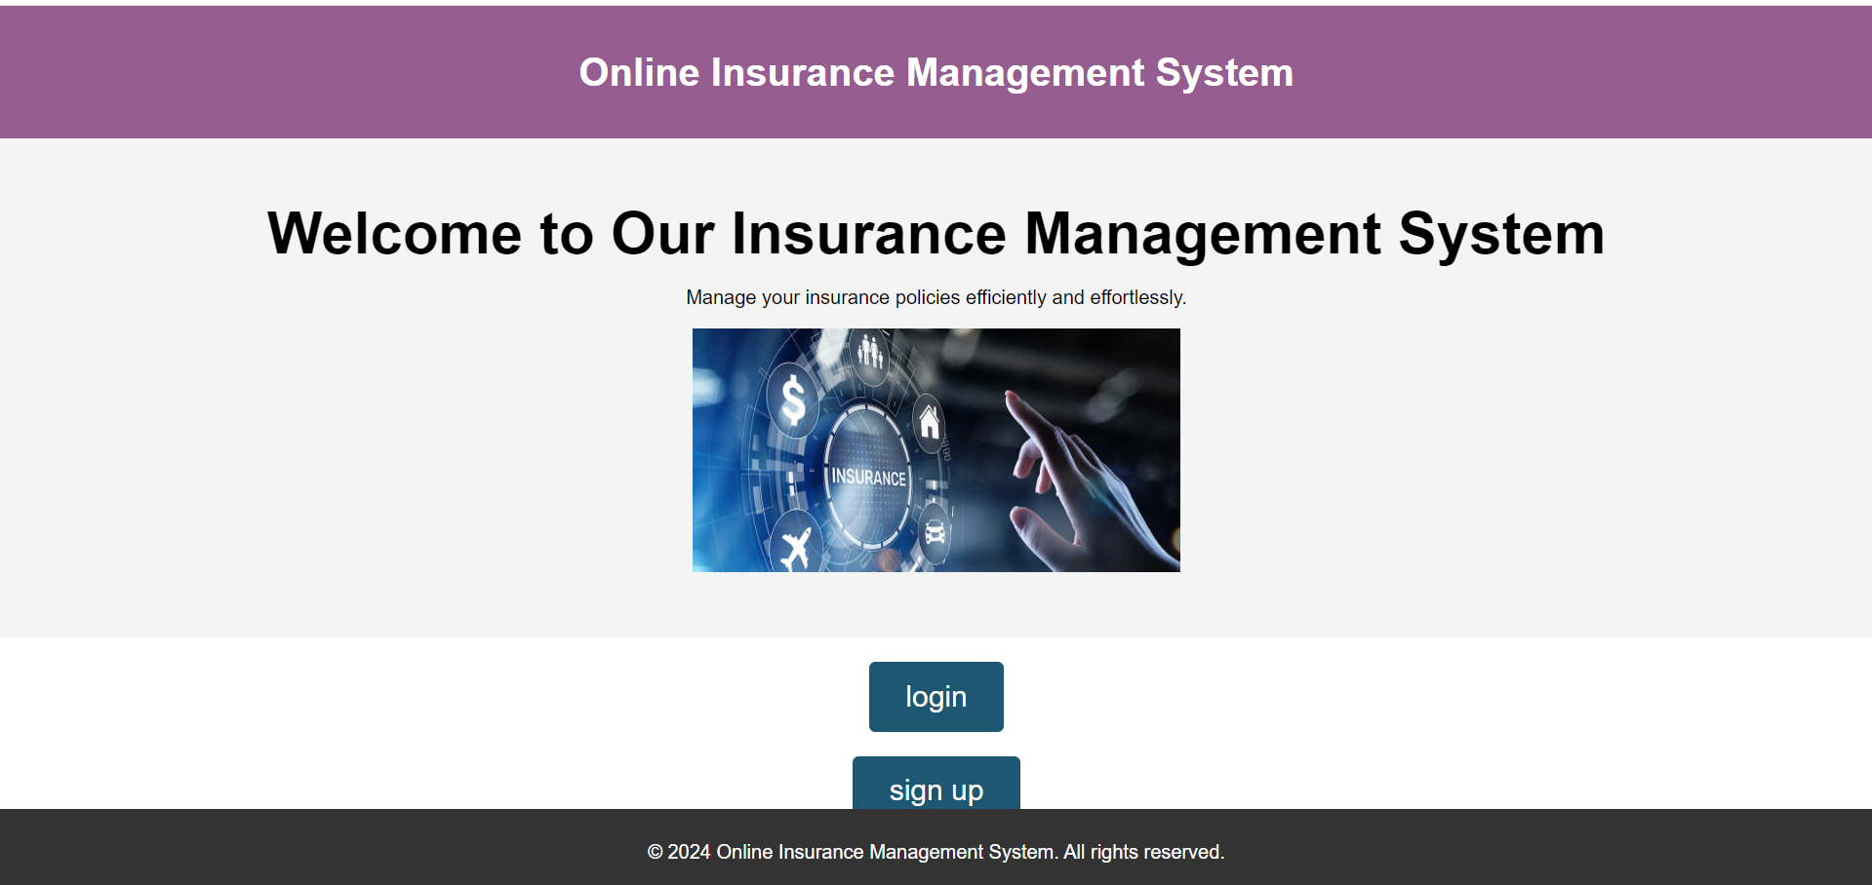
Fig.1.1.user login/sign up page

Slide 11
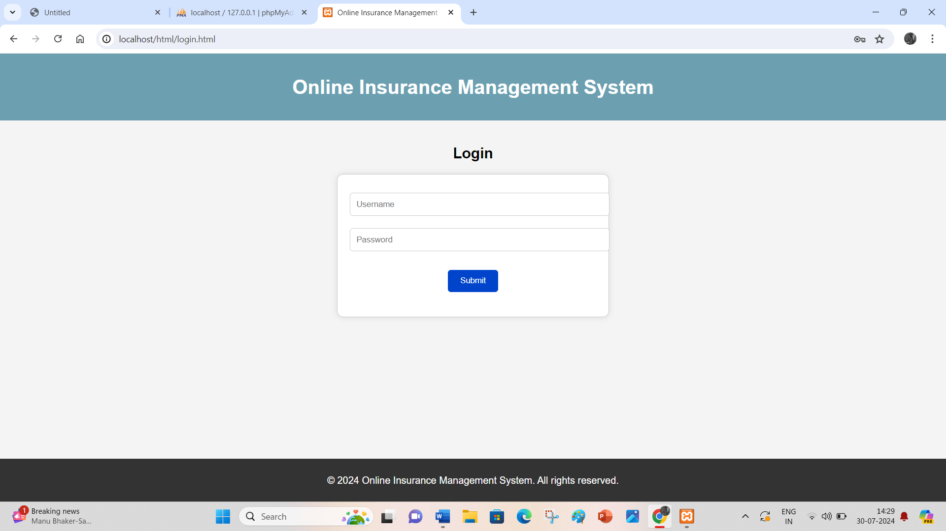
Fig.1.2.login page

Slide 12
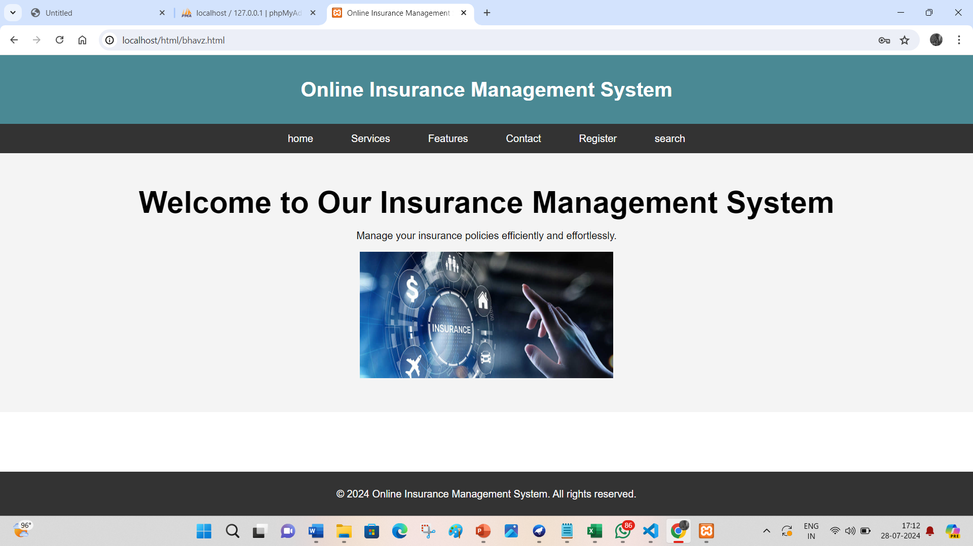
Fig.1.3.Home page

Slide 13
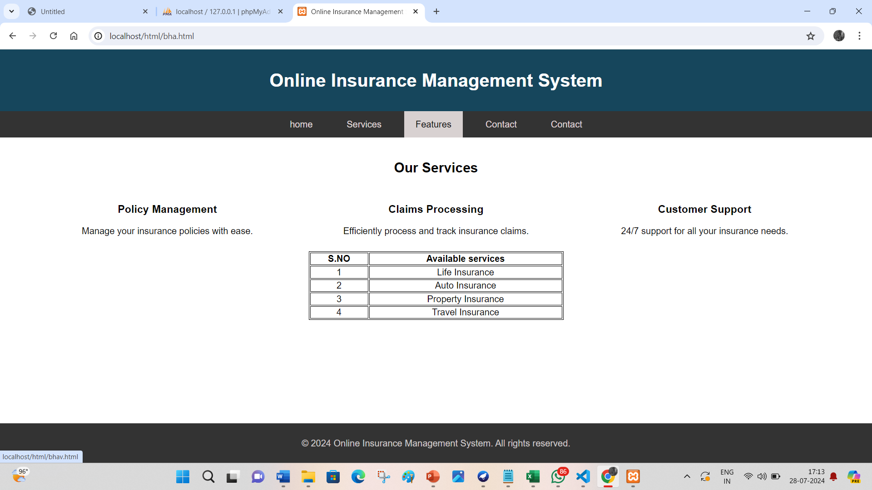
Fig.1.4.Service page

Slide 14
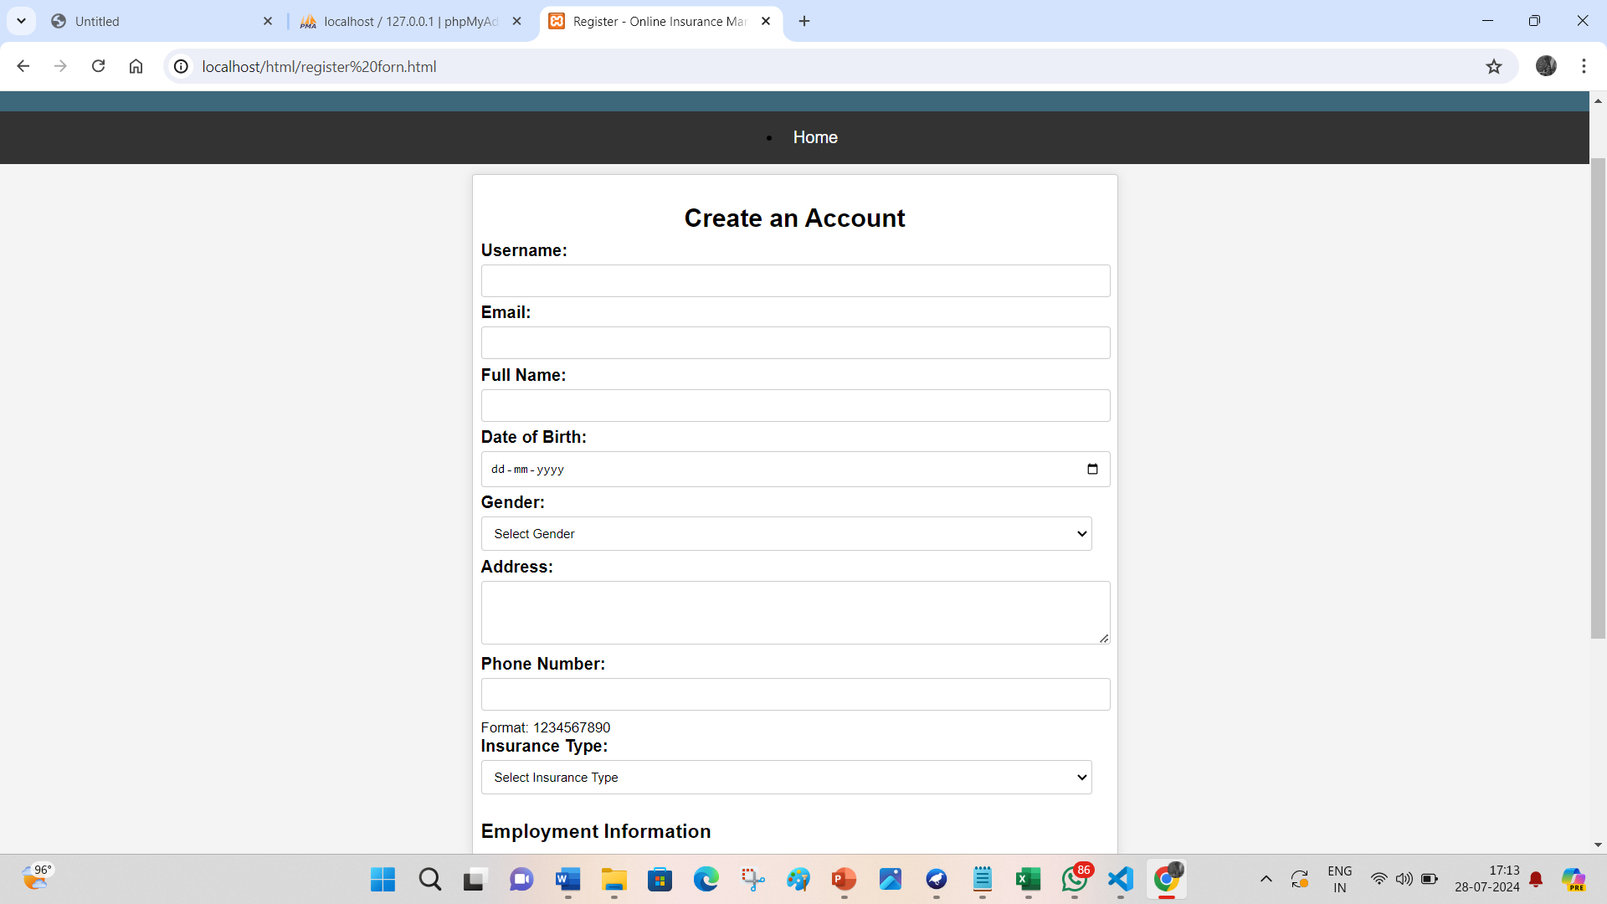
Fig.1.5.Registration page

Slide 15
Thank you

